Slide 1
Azure Brushup

Slide 2
















Slide 3








Azure AD
Users
Groups
Service Principles

Slide 4



Grant Role Based Access Control
User1 – App A
User2 – App B
User3 – App C
User4 – App D
Group 1 – App A
Group 2 – App B
Group 3 – App C
Group 4 – App D
Group 5 – App R
Subscription 1 – App A and App B
Resource Group A
Resource Group B
Subscription 2 – App C, App D and App R
Resource Group C
Resource Group D
Resource Group R
Subscription 1
Resource Group
App A
Resource Group
App B
Subscription 2
Resource Group
App C
Root Management
Group
Resource Group
App D
Resource Group
App R
Custom Role
Or Contributor
Group 1
Group 2
Group 3
Group 4
Group 5

Slide 5
Virtual Machine
Add Tags
Naming Convention
Backup – Prod VM
Disaster Recovery – Prod VM
Stop when not in use – Save Compute Cost
Do not expose to public IP

Slide 6
Storage Account
Tags
RBAC
Redundancy
Access Levels for Blobs
Secure Transfer enabled – HTTPS
Encryption
Use SAS whenever required
Soft Delete
Hot, Cool and Archive – Create Lifecycle Management Rules

Slide 7
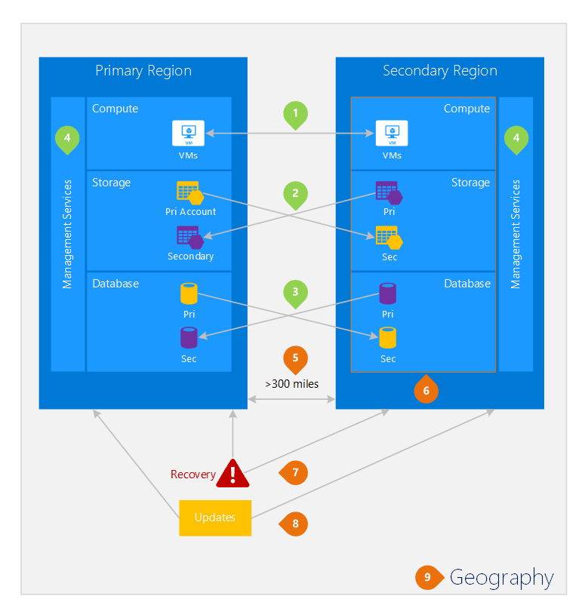

Slide 8
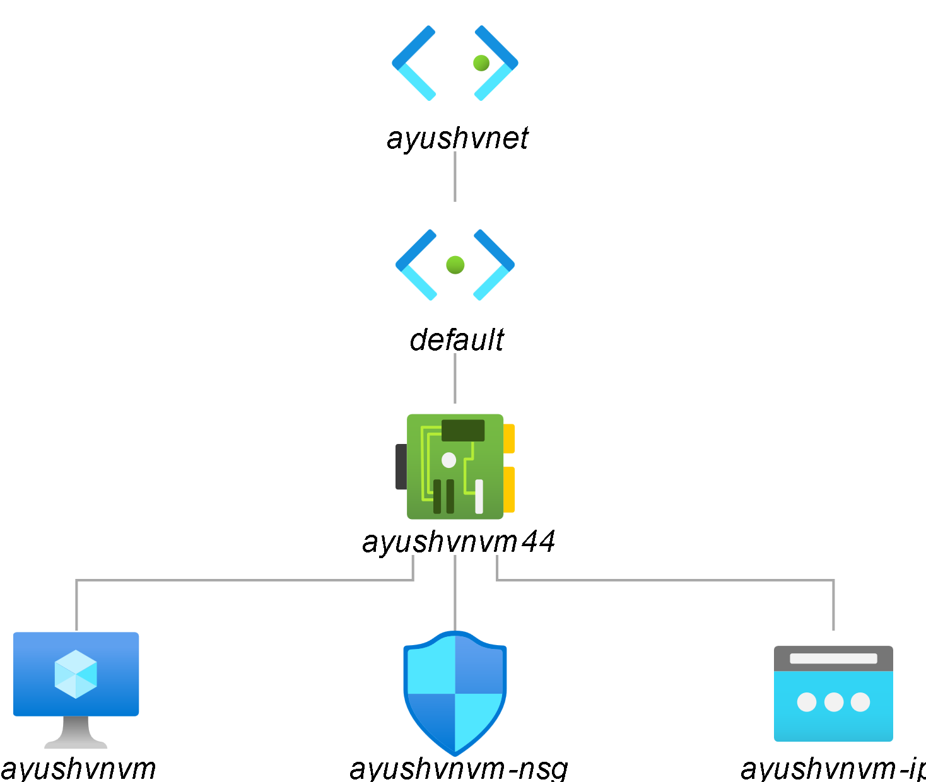
Virtual Network
Have enough unallocated space
Different subnets for different ties
NSG at the subnet

Slide 9
Load Balancer
Frontend Configuration
Backend Pool
Health Probe
Load Balancing Rule

Slide 10
Load Balancer
Application Gateway
Traffic Manager
Front Door

Slide 11
PaaS Offerings
Azure App Service
Kubernetes Service
Container Instance

